Slide 1
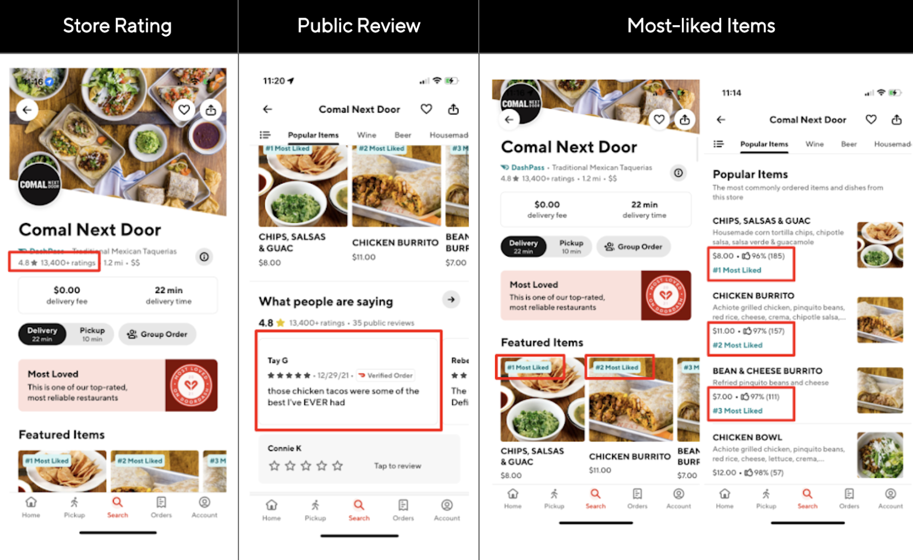





Sentiment Analysis of Scraped
Talabat Reviews Using NLP
NLP & BI Integration
Advanced Analytics Pipeline
Multilingual Analysis
Arabic & English Reviews
Interactive Dashboard
Business Intelligence
Katrine Baqaeeen
4,216+ Reviews
[202120564]
15 Restaurants Analyzed
Graduation Project | First Semester, 2025/2026

Slide 2

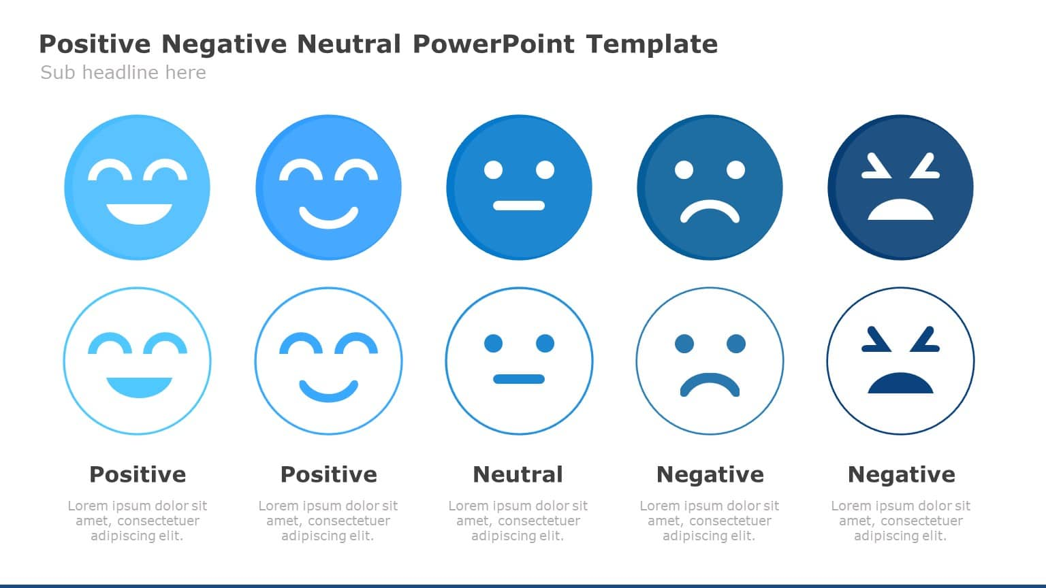





Abstract & Introduction
Why This Topic?
Food industry = most in-demand sector in Jordan
Talabat: heavily used, high % of reviews
Analyzing reviews provides meaningful insights for decision-making
Text
Unstructured data
Why Text Reviews?
Emotions
Experiences
Problems
Details
Very useful to analyze
NLP + Sentiment Analysis
Identify problems
Find strengths/weaknesses
Monitor trends
Sentiment Classification: Positive / Neutral / Negative

Slide 3







Project Objectives
01
02
03
Analyze Sentiment
Extract Insights
Support Decisions
Customer Sentiment
Business Intelligence
Strategic Planning
Track sentiment trends
Identify problems & features
Improve service quality
Detect spikes (+15%) & drops (-15%)
Find strengths/weaknesses
Enable better customer choices
Measure satisfaction levels
Performance monitoring
Monitor sentiment intensity
Key Performance Questions
Improving over time?
Receding?
High drops/spikes?
Stable?
Food industry is highly competitive → Continuous monitoring recommended

Slide 4

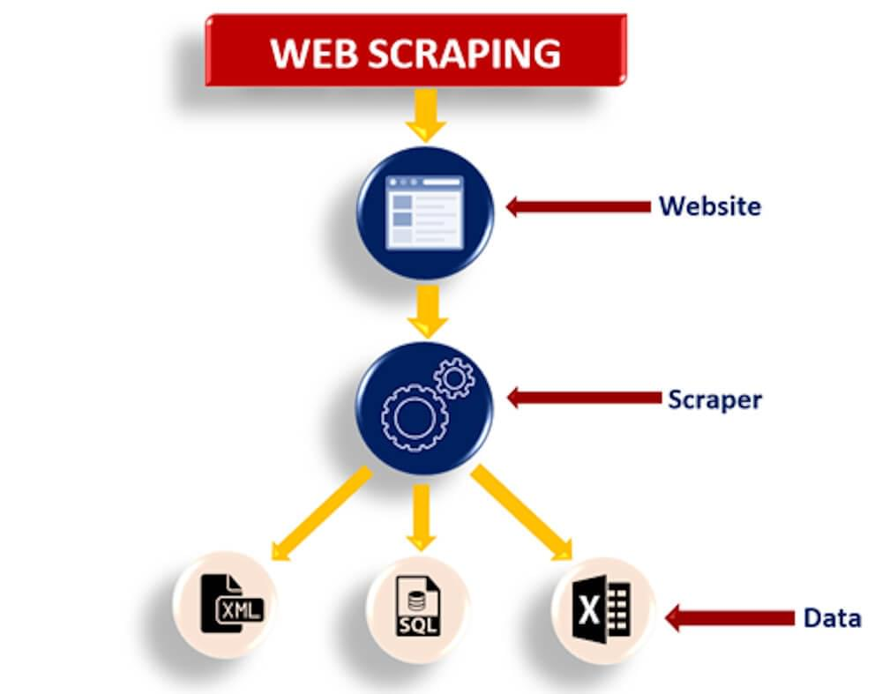




Data Acquisition
Challenges with Data Collection
Can't ask every customer
No downloadable datasets
Dynamic data (new feedback/customers)
Static datasets become outdated
Why Web Scraping?
100% Authentic data
No cleaning overhead
Tailored attributes
Avoids: Outdated • Limited • Unnecessary fields • Lacks relevance
Learning Challenge
Restaurant Selection
Self-study (outside BI)
No prior experience
15 diverse restaurants
HTML structure study
Different review volumes
Variety of cuisines
Technical Implementation
Web Scraping Architecture
Dynamic loading (APIs)
Request link per restaurant
Branch ID mapping in code

Slide 5
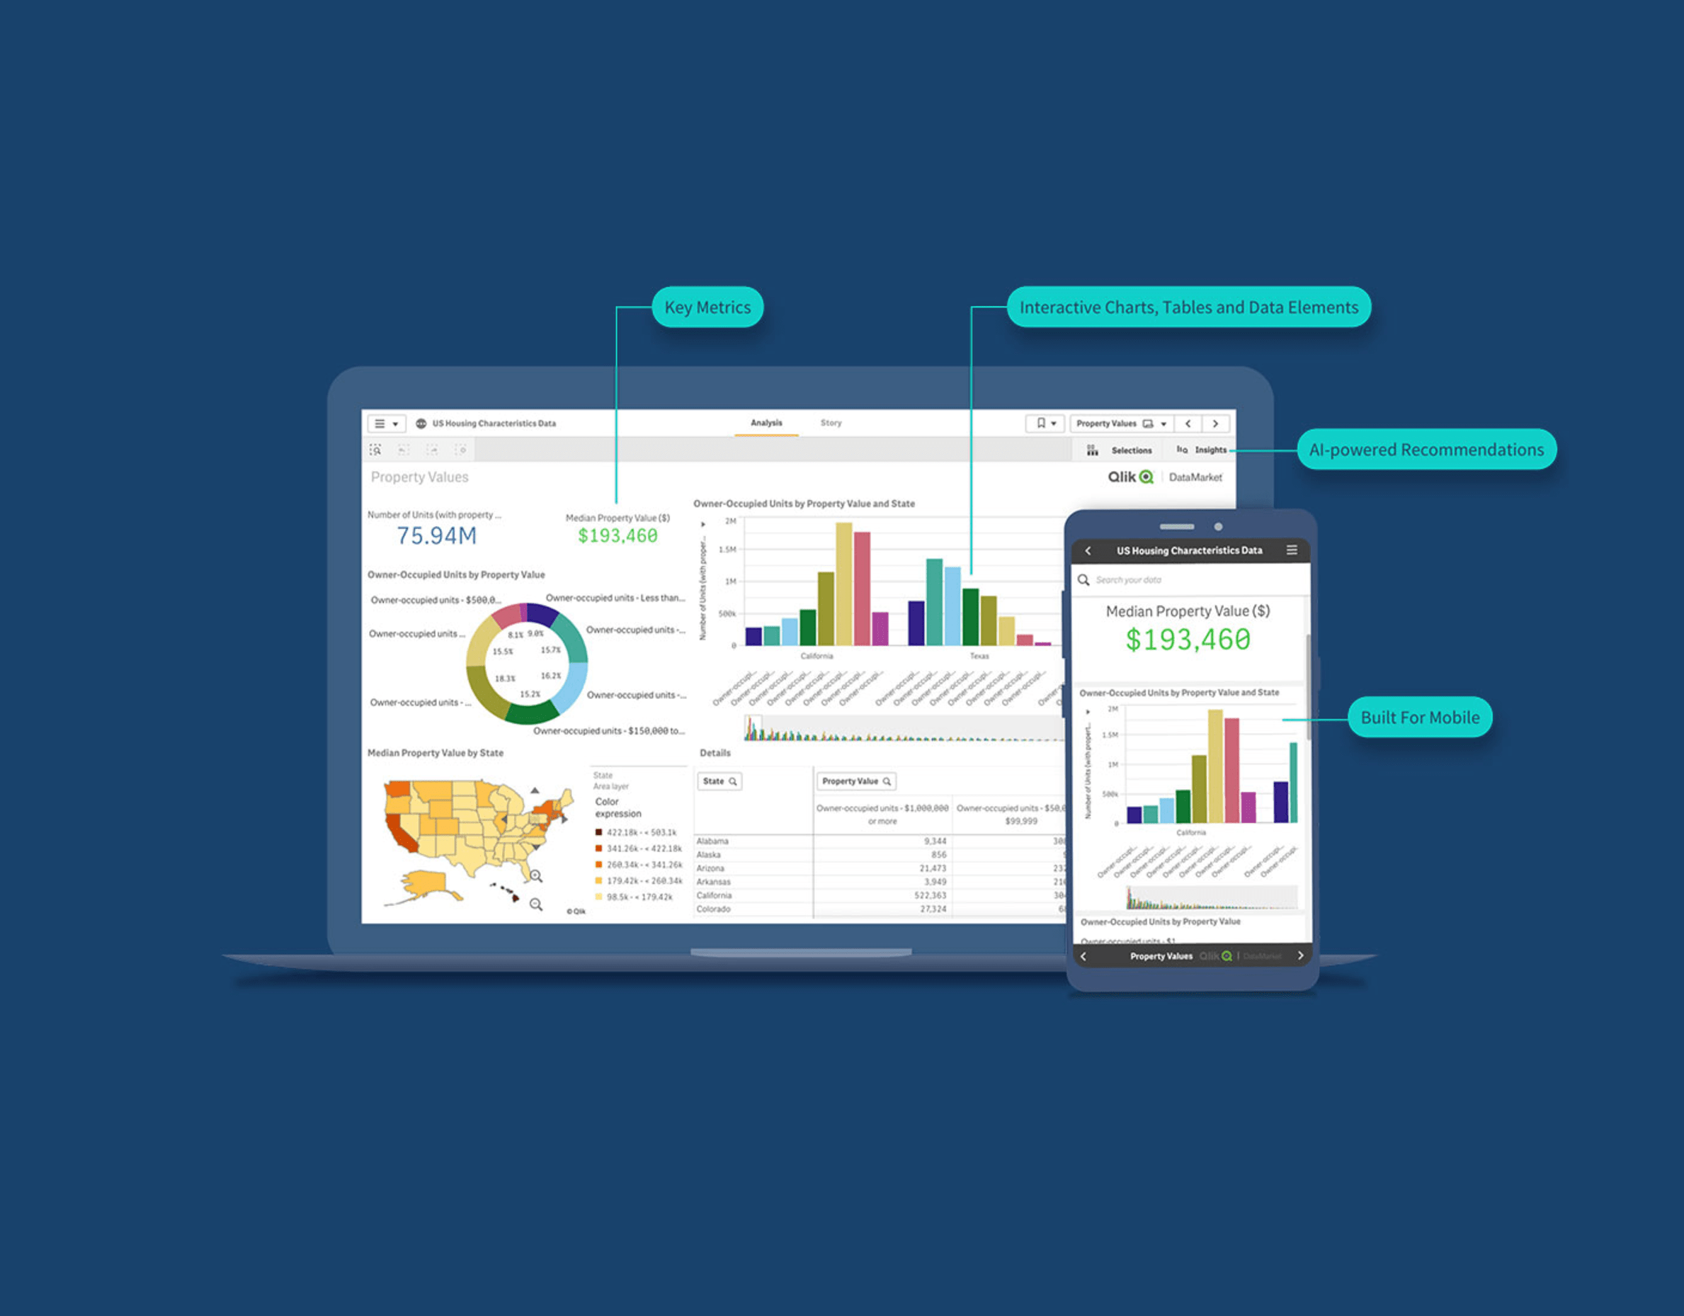
Data Description
1
Raw Reviews
restaurant_name
review_date
rating (1-5)
review_text (Arabic/English)
2
Sentiment-Enriched
cleaned_text
model_star (1-5)
model_confidence (0-1)
final_score (-1 to +1)
final_sentiment
top_words
3
Restaurant Insights
top_problems (negative categories)
top_positive_features
4
Timeline Analysis
year_month (YYYY-MM)
review_count
avg_final_score
sentiment ratios
sentiment_event
Threshold: Minimum 10 reviews/month for statistical reliability
5
Problem Timeline
Interactive Power BI Dashboard
detected_problem
problem_count
problem_percentage

Slide 6






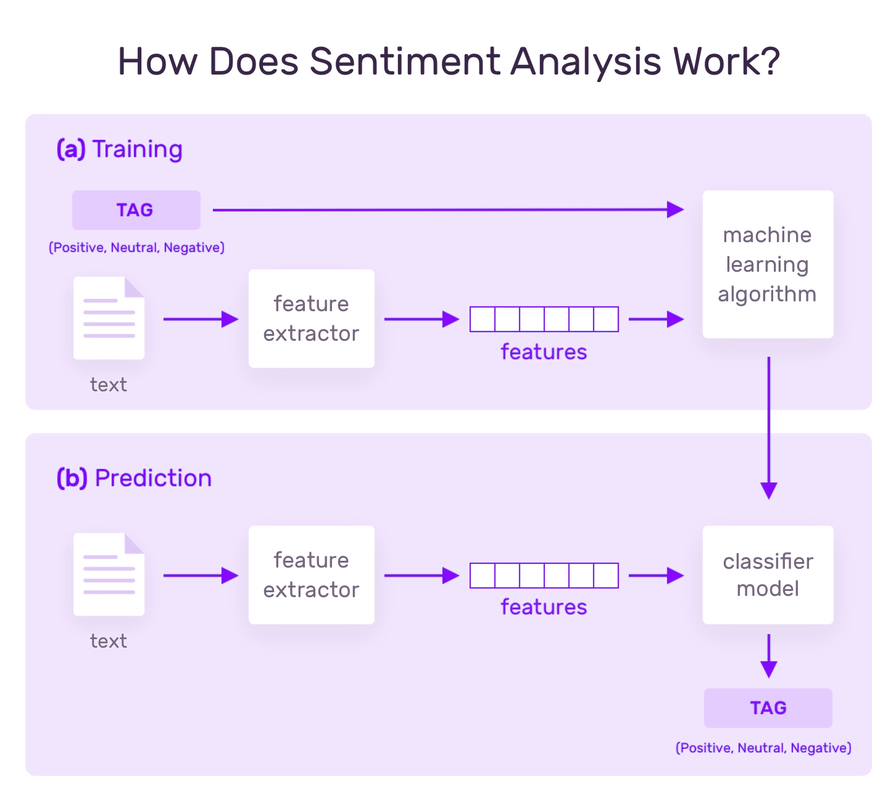
Feature Engineering
Data Cleaning & Transformation
Cleaned text
Model predictions
Arabic detection
Stopwords removal
Confidence scores
Final score (70/30)
Post-sentiment translation
Temporal Aggregation
Year-month format
Monthly metrics
Change detection

Slide 7






Multilingual Challenges & Language Standardization
The Challenge
Same issues in different languages treated as different topics
Fragmented results reducing clarity
The Solution
Translate to English after sentiment analysis
Unify dataset for consistency
Benefits
Consistent semantic analysis
Cleaner visualizations
Unified categories
Stopword Lists
Sentence Splitting
Timing
Post-sentiment translation
Custom Arabic list + English removal
Granular analysis
Arabic & English Processing Pipeline

Slide 8

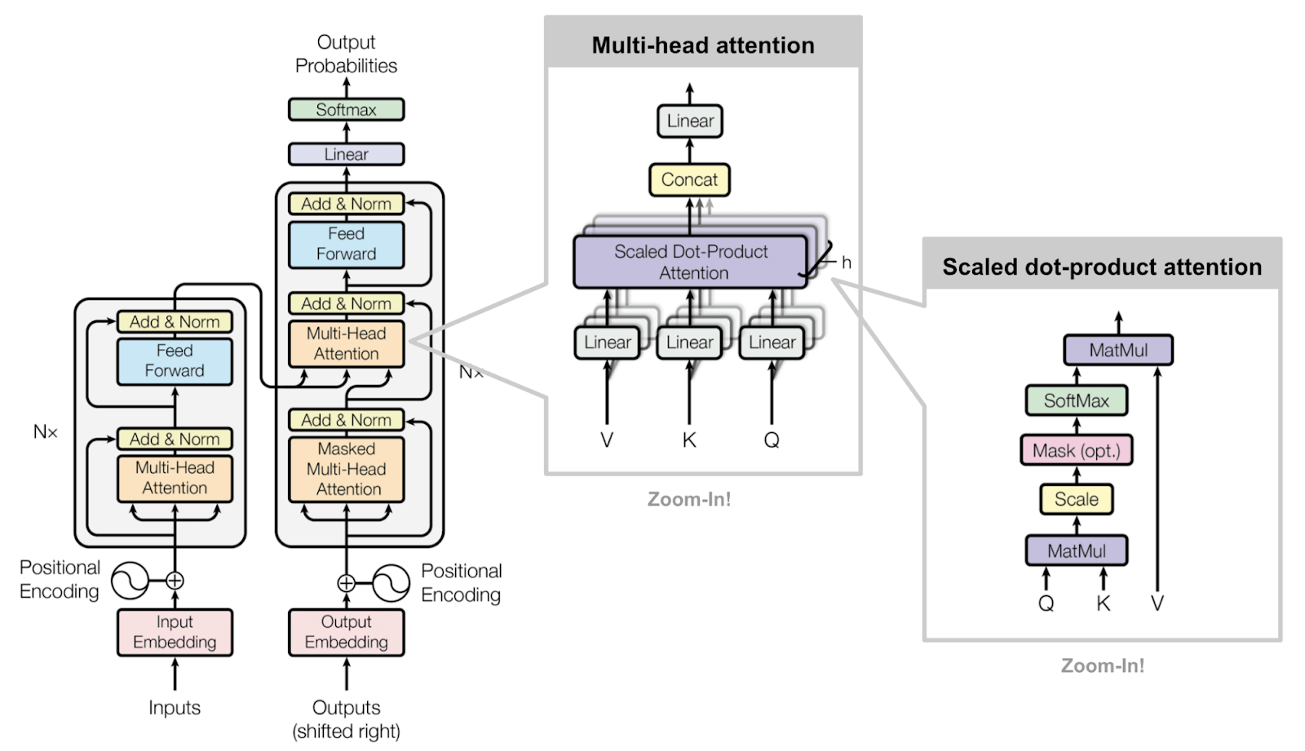

Advanced Analytics & AI Modeling Overview
Multi-Stage AI Modeling Framework
Five specialized models for comprehensive analysis
Multilingual Transformer-Based Sentiment Classification
1
BERT model for sentiment prediction with confidence scores
2
Hybrid Sentiment Scoring & Weighted Ensemble
Combining NLP predictions (70%) and user ratings (30%)
Semantic Similarity Model
3
Extract problems and strengths using sentence embeddings and cosine similarity
Temporal Sentiment Analysis & Event Detection
4
Track sentiment trends over time with spike (+15%) and drop (-15%) detection
Zero-Shot Classification for Monthly Problem Detection
5
Identify specific problems from negative reviews without training data
BERT Transformer Architecture
Each model serves a specific analytical purpose rather than single algorithm approach

Slide 9
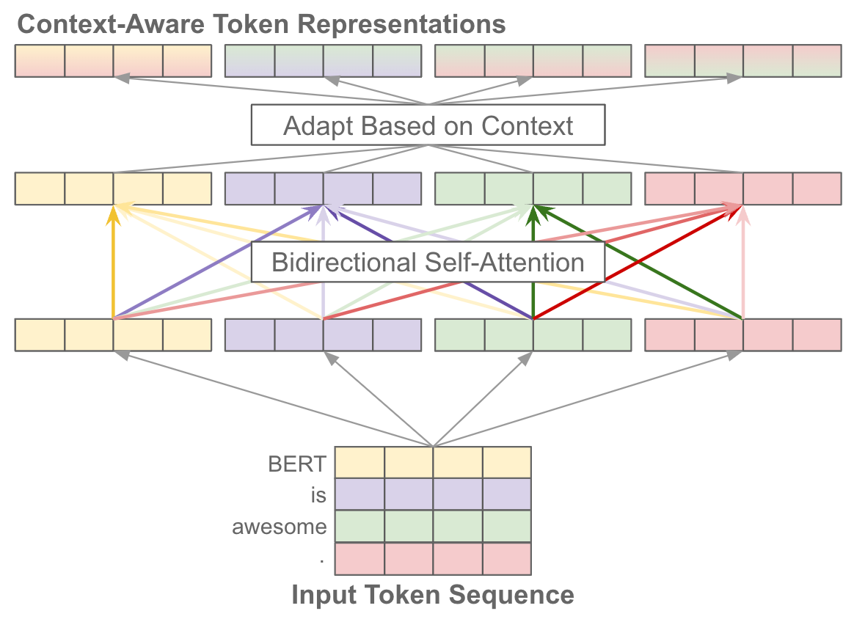


Model 1: Sentiment Classification
nlptown/bert-base-multilingual-uncased-sentiment
Hugging Face Platform
BERT Process
1. Tokenization
2. Embeddings
3. Self-Attention
4. Positional Info
• Numerical representations
• Weights based on importance
Model Advantages
Understands context
Semantics from both directions
Processes simultaneously
Understands sentence order
Output Results
1-5 Star Scale
Different sentiment levels
Matches original ratings
BERT Self-Attention Mechanism

Slide 10
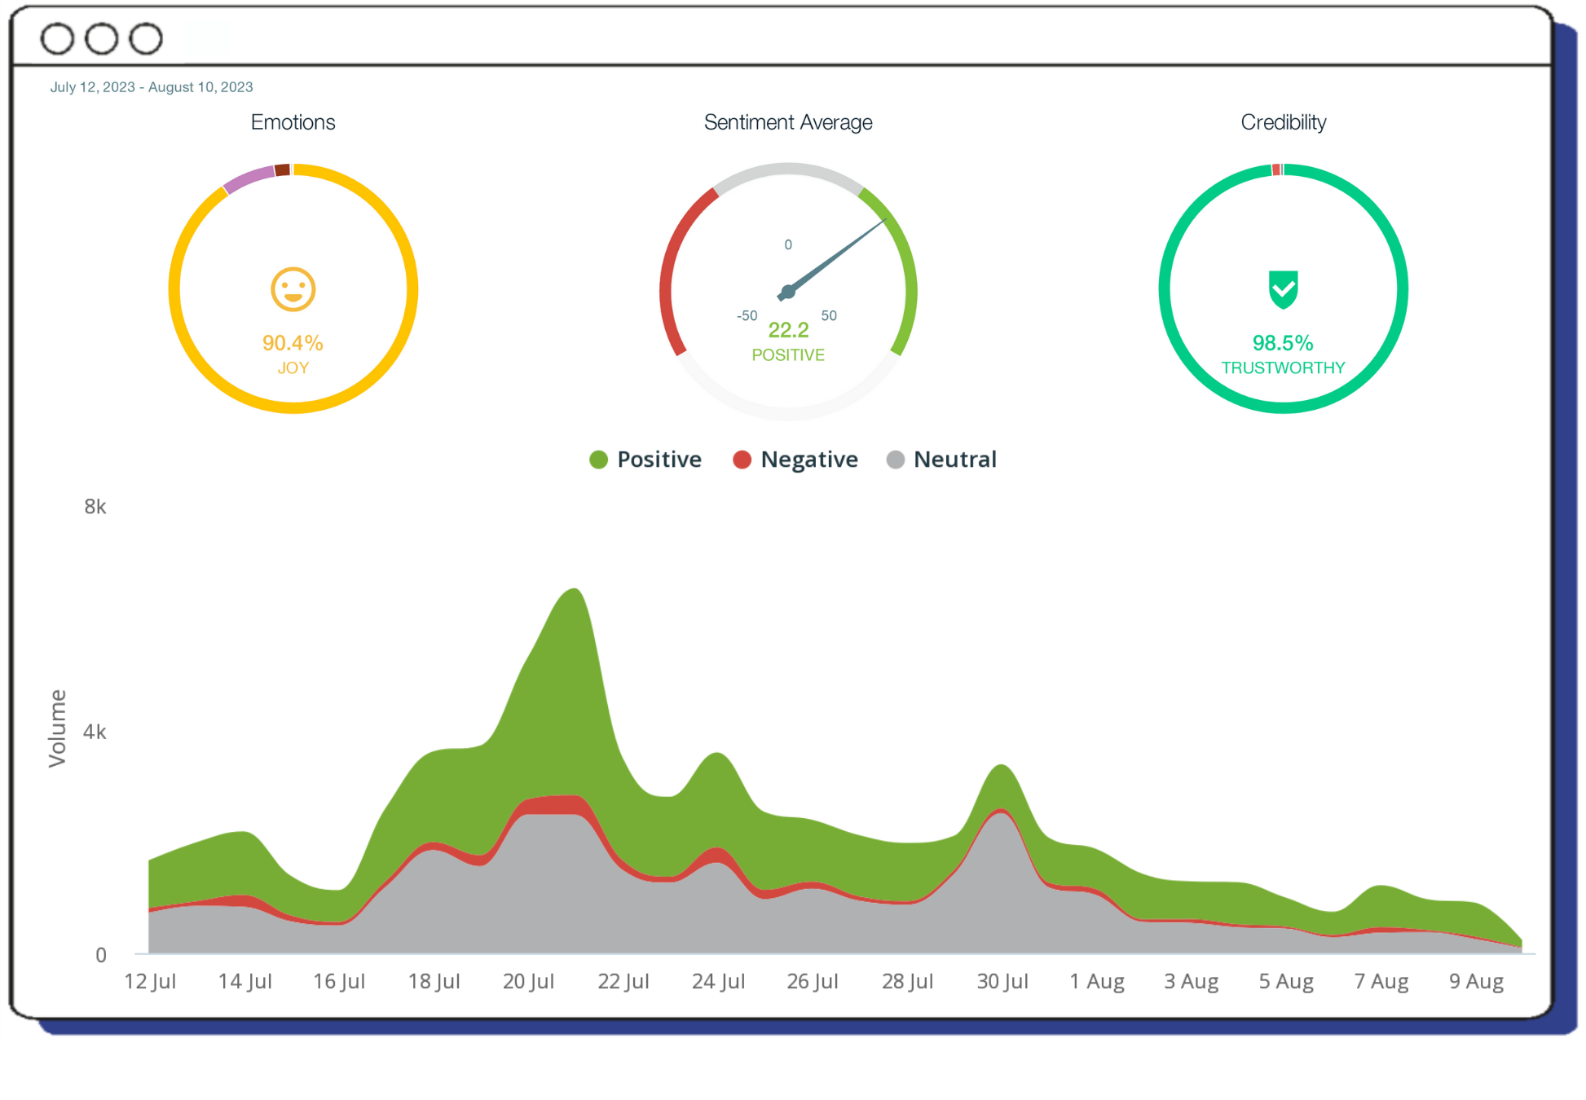




Model 2: Hybrid Scoring
Motivation
Ratings alone can be biased
NLP may misinterpret intent
Weighting Strategy
NLP Model Prediction
70%
Original User Rating
30%
Key Benefit: 30% rating reduces misclassification & gives better accuracy
Output
Not Enough Alone
Continuous score (-1 to +1)
Need to transform to useful insights: complaints, satisfaction/ dissatisfaction, strengths & weaknesses
Positive / Negative / Neutral
Sentiment Scoring Dashboard

Slide 11

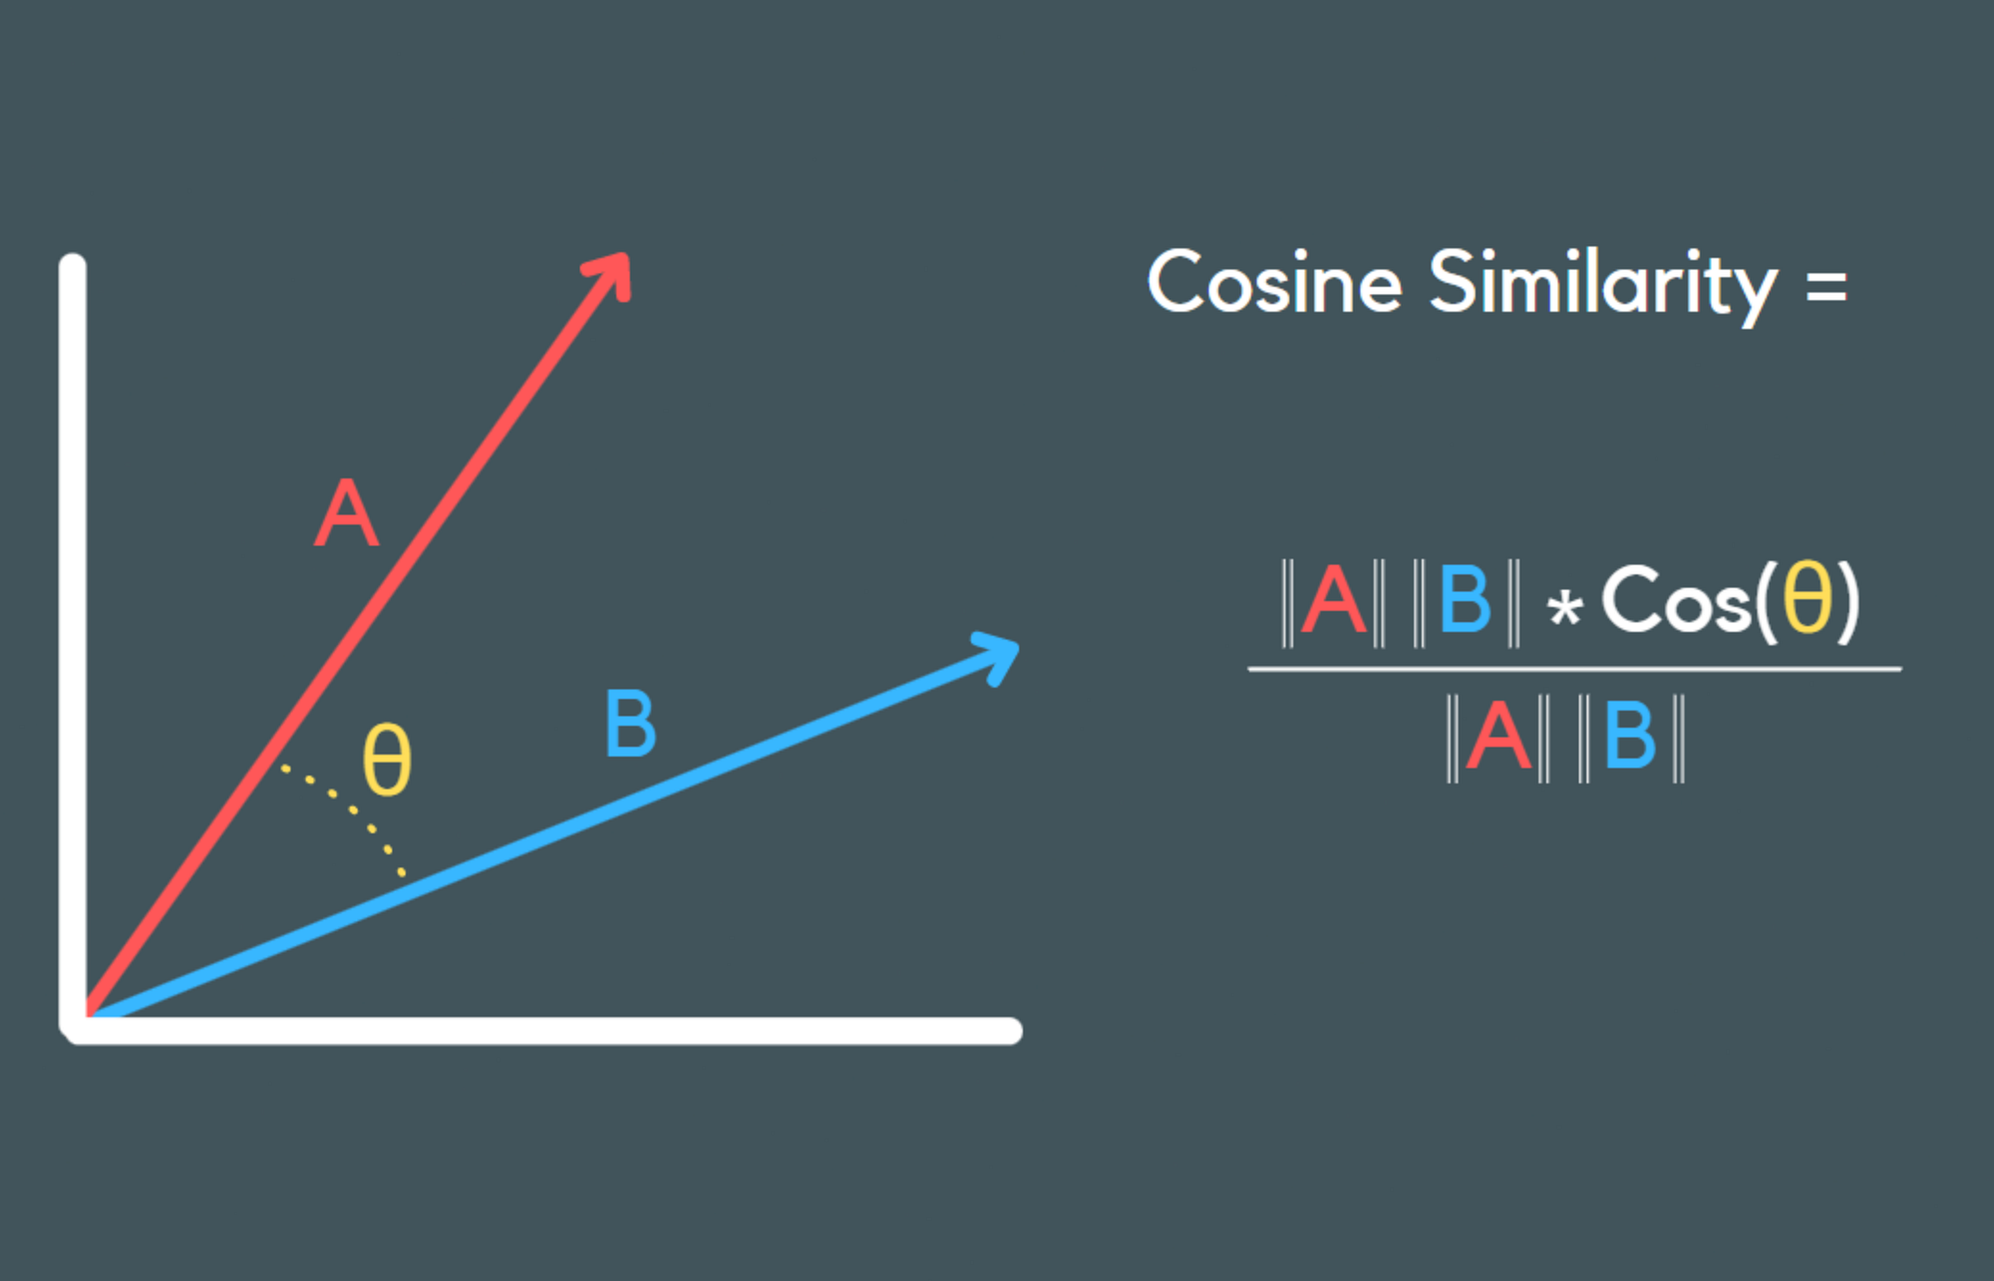



Model 3: Semantic Similarity
paraphrase-multilingual-MiniLM-L12-v2
SentenceTransformer • Hugging Face
Key Advantage: Cosine Similarity
Our Method
Traditional
Sees similarity between two items
Keyword matching only
Method
Translate to English
Split sentences
Sentence embeddings
Cosine similarity
Outcome
Semantic Benefit
Negative: Top problems
Understands meaning
Positive: Top features
Beyond exact wording
Percentage contributions
Contextual matching
Cosine Similarity Visualization

Slide 12

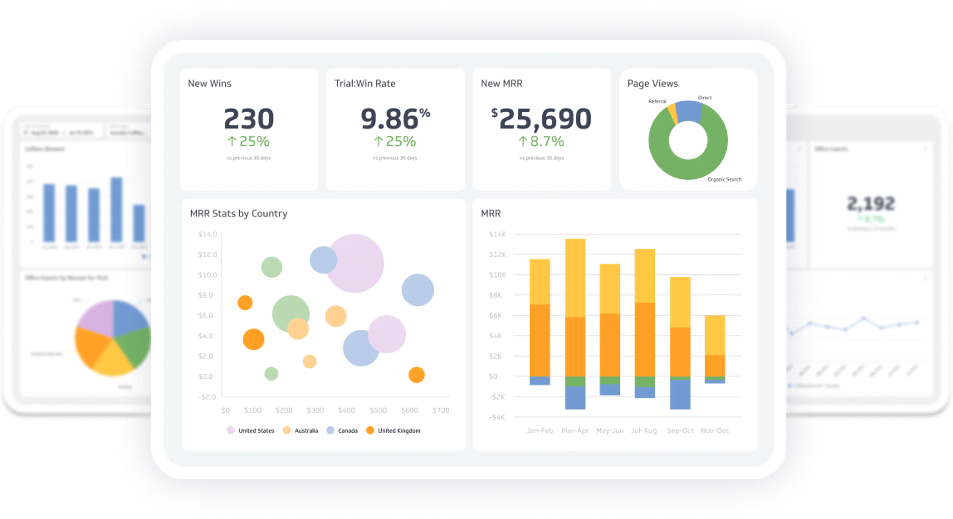




Model 4: Temporal Analysis
Why Temporal Analysis?
Very important BI topic
Time-based analysis
Satisfaction dynamic
Changes & fluctuates
Why Monthly Timeline?
Daily
Monthly
Yearly
Too much noise
Optimal balance
Not useful enough
Encoding
Monthly Goal
Qualitative → Quantitative
Why drops happened
Sentiment metrics
Reasons for changes
Problems in specific month
Event Detection Thresholds
+15%
-15%
±15%
SPIKE
DROP
STABLE
Interactive Timeline Dashboard
Improvement
Deterioration
Normal

Slide 13

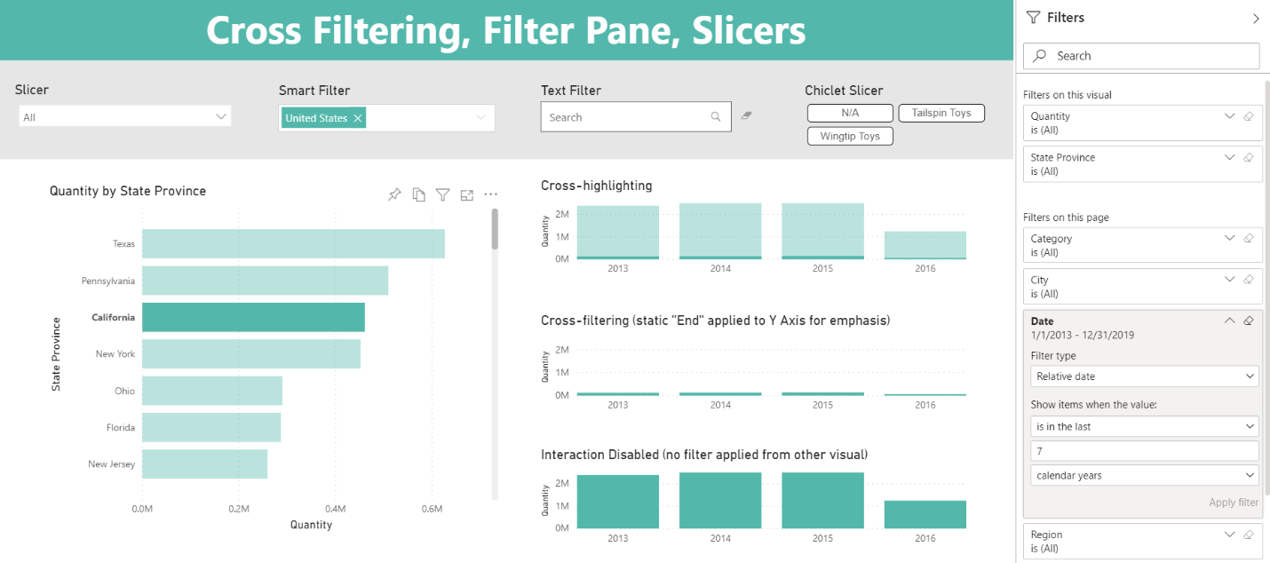




Model 5: Zero-Shot Classification
facebook/bart-large-mnli
Zero-Shot Classification • Hugging Face
Key Advantages
Temporal Monitoring
Multiple Problems
Ideal for time-based analysis
Captures several from single review
Why Zero-Shot?
No training data
Flexible categories
Reduced overfitting
Ideal for: Exploratory & evolving datasets
Implementation & Outcome
Applied to:
Result:
Negative reviews only
Monthly problem frequencies
Monthly Problem Analysis Dashboard
Format:
Goal:
Percentages for comparison
Ranked visualizations

Slide 14

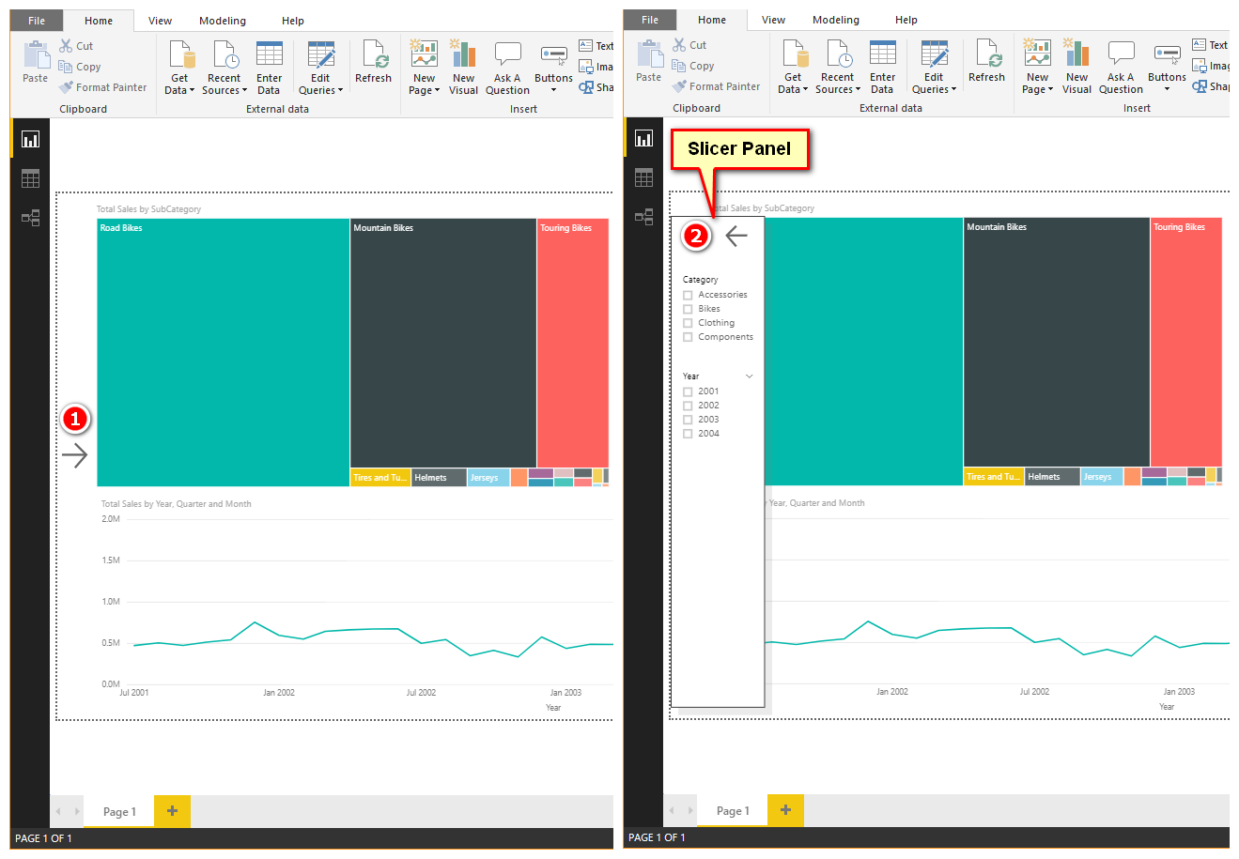




Power BI Dashboard & Deployment
Visualization Goal
Easy to read
Easy to compare
Interpretable & actionable
Raw Data → Insights
Patterns
Trends
Anomalies
Enables: Decision support
Dashboard Features
Interactive visualizations
Dynamic slicers
Comparative metrics
Drill-down analysis
Multiple chart types
User-friendly interface
Deployment
Value
Power BI integration
Dynamic exploration
Interactive Power BI Dashboard
Real-time updates
Performance comparison
Exportable reports
Data-driven decisions

Slide 15






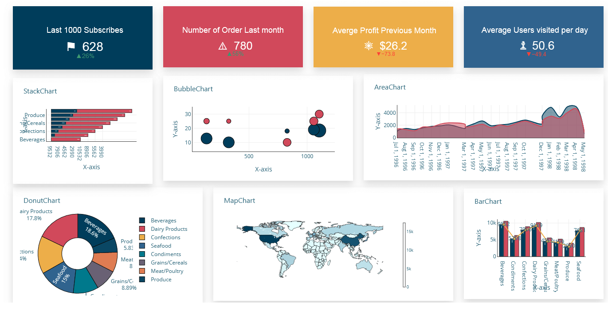


Key Results & Insights
Overall Brand Health
Top Problems
34% Negative Feedback
(Critical Flag)
Taste & Flavor
Between 3 people, 1 is dissatisfied → Improvements needed
Most dominant issue
Example Solutions
Kitchen staff training
Business Question
Ingredient quality increase
"Are we meeting customer expectations?"
Answer:
NO
Shawerma Reem
47% happy, but 34% negative > industry standards
Systematic
Failure
Critically Underperforming
Brand Fatigue
Xn Shawerma
Dominos
Significant issues
Service gaps
Review Distribution
Restaurant Stability
U-shape distribution
Burger Maker
High at extremes (1 & 5)
Most reliable (21 stables)
Low in middle (2-4)
99 Grill
High fluctuations

Slide 16




Conclusion, Future Work & Acknowledgments
Github:
https://github.com/Katrine164/Graduation-project.git
Summary
Power BI:
https://app.powerbi.com/links/uaglO44oFg?ctid=97e5760c-fa12-4aae-b4e4-31b43f04e79d&pbi_source=linkShare
Unstructured data → Useful Insights
Complete AI pipeline
BI + AI synergy
Open-Source Tools:
Key Achievements
• Hugging Face
• Google Colab
High-accuracy sentiment analysis
Monthly problem detection
• Microsoft Power BI
• Python
Interactive Power BI dashboard
Strengths , Weaknesses
Future Directions
Thank You!
Expand to more restaurants
Real-time analysis
Questions & Discussion
Management system integration
Advanced NLP techniques
Katrine Baqaeeen [202120564]
Graduation Project • First Semester 2025/2026

